Slide 1
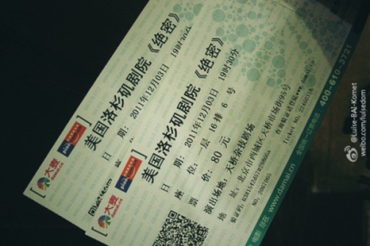
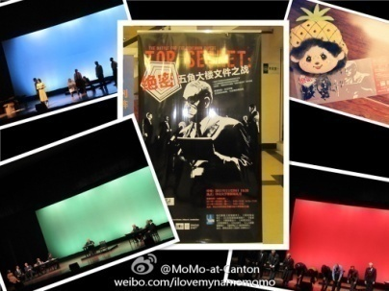
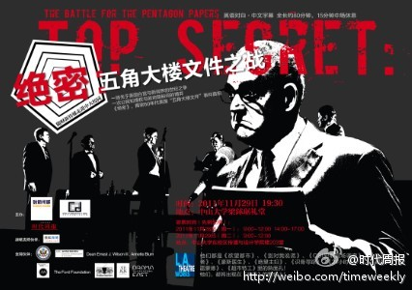
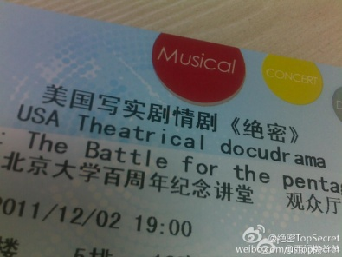
Weibo Work of
Top Secret

Slide 2
Contents
Part1: Our work
Part2: Feedbacks
Part3: Evaluation

Slide 3
Part1: Our Work

Slide 4
Identity
Identity of the account
Identity of the person behind the account
Account’s Identity: Official account of the play
Company: Los Angeles Theater
Location: Los Angeles
My Identity: A Chinese employee of Los Angeles Theater
Location: Los Angeles

Slide 5
General Strategy
@上海话剧艺术中心(Shanghai Drama Art Center)：40,000 fans
@美剧迷(American TV series Fans)：3,000,000 fans
Main Account
@美剧资讯(American TV series updates)：40,000 fans
Nuclear Mode
“Flower” Mode
@绝密TopSecret：
20 fans
@ YYeTs人人影视(Renren Movie)：360,000 fans

Slide 6
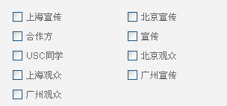
Specific Works
Content creating
Background knowledge
Time and Ticket information
Inside stories
Fan base building
Transformation (customer service)
Answer questions
Create conversations
Fan base categorization

Slide 7
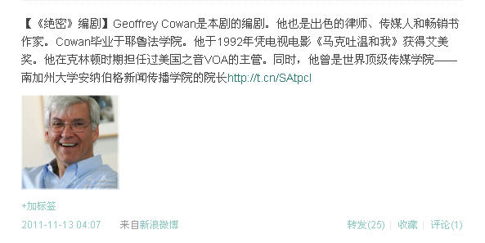
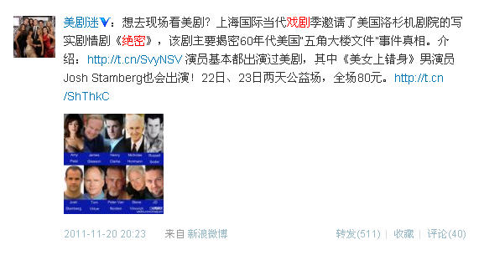
Tag
URL
Creating
Content
Picture
@美剧迷(American TV series Fans) ：3,000,000 fans
Creating
Conversation/
Transformation
FW: 511
RE: 40

Slide 8
Part2: Feedbacks

Slide 9
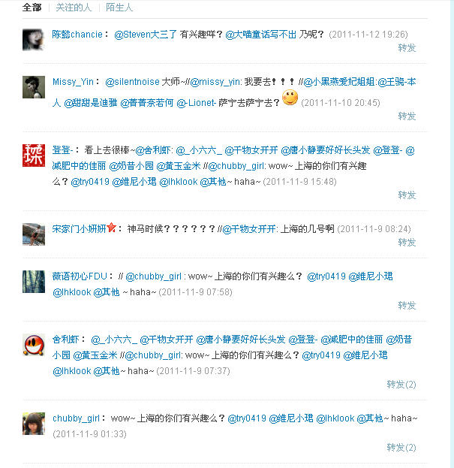
Before they watch it
@A are you interested to go? @B how about you?
@C: I wanna go!!! // @E: @F @G @H who wanna go with me?
@I: looks great~// @J*: @K @L @M…… wow~ you guys in Shanghai, wanna go? @N @O @P ~haha~
@Q: when??????// @R: when will they come to Shanghai?
@S://@T: @U @V @W…… wow~ you guys in Shanghai, wanna go? @X @Y @Z ~haha~

Slide 10
A Beijing audience who was a J-school student of Fudan University
Hi, I was surprised when you added me as your friend. I’m looking forward to your Beijing performance in December. Even today, I still remember the hot class discussion of Pantagon papers case when I was in Fudan. BTW. Bill Berkeley was my teacher in Fudan University. He sent me an email and recommended the Top Secret.
A student of Sun Yat-San University
Liangqiuju Theater, Top Secret from LA Theater, let me see how many US TV series stars I can recognize.

Slide 11
After they watch it
Positive reviews
A lawyer in Beijing
Top Secret, which is about…, reveals the conflict between “the secrecy of government” and “the people’s right to be informed”. I think a country with an adequate law system should follow the rule of “the openness is common, the secrecy is exception.”
It’s a pity that many audience showed up to see the star actors. In fact, this drama was terrific too. The director is great. Actors are wonderful. The lines are smart. Even if the props were only several tables and chairs, the play was fabulous and well-worth watching.

Slide 12
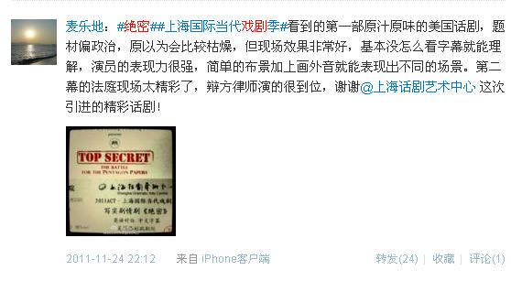
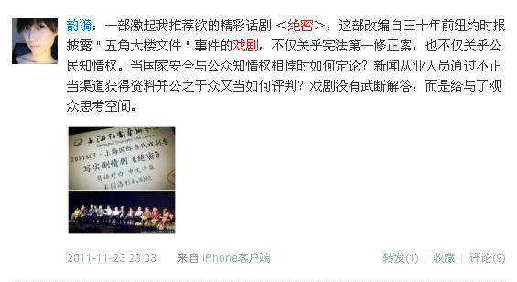
It was my first time to watch an American play. Knowing it was about politics, I thought it would be boring. However, the performance was great. I could understand the lines even if I didn’t look at the subtitles. I love the Act 2.
It’s a play that I strongly recommend. It’s not only about the First Amendment, but also about people’s right to be informed. … How to judge it? The play didn’t give us an ultimate answer, but allow us to think about it by ourselves.

Slide 13
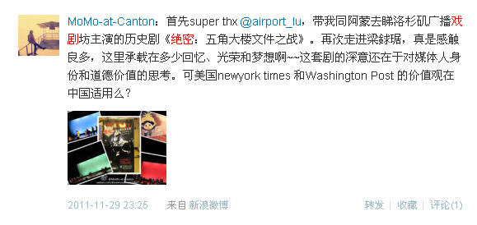
Neutral reviews
…This play is exploring the identity and ethnics of the media people. But can the value of NYT or WSP adapt to China?
Although there was subtitle, they were too fast to read. The play presented us an important moment in the US history, which provided us a new angle to think about their people and system. The only shortcoming of the performance was their marketing strategy.

Slide 14
Negative reviews
The story of Top Secret would never appear in China. Our current social and political environment is actually contradictory to what is in the play. This play could pass the censorship probably because the support from the American Embassy. It’s an explicit marketing of American spirit.
The play was bad. I’m confused about why the audience were laughing and applauding, which were ridiculous. They handed out the brochure to us because they knew we couldn’t understand it without the introductions on the brochure.
I knew it would be an “English corner”* when I heard about the play. It turned out to be true.
*English corner is the place in many Chinese cities where people gather and practice their spoken English.

Slide 15
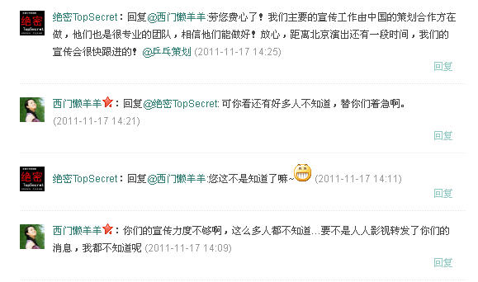
Problems
Why Beida’s theater doesn’t have an air conditioner? The actors were freezing, and are running their noses. My hands were cold, and I was shaking. Beida you did 99%, why didn’t you complete the last 1%? Disappointed.
M:
Thank you very much！ Don’t worry. Our partner in China is very professional, and they will do it well!
A:
But many people still don’t know. I’m worrying about it
M:
Obviously now you know it ☺
Your promotion is not enough! So many people still don’t know. If @人人影视 didn’t post the news, I won’t know about it
A:

Slide 16
Part3: Evaluation

Slide 17
Evaluation
Content creation: 8/10
Connecting/transformation: 6/10
Analysis: 5/10
Audience targeting: 7/10
Overall promotion: 7/10

Slide 18
How to do it better
Prepare it early
Take all available resources into consideration beforehand (efficient communication among all parties involved)
Analyze it better
Beware of the backfire of the strategy (consistency)

